Slide 1
PMP FasTrac
Workshop by
AstroWix, India
®
Notes:
Project Management Concepts
Version 3.1, 4/01 © 2003 by AstroWix

Slide 2
Faculty & Participants
An Introduction
Name, Company, Current Designation, Why Certification, Hobby

Slide 3
Top 10 Reasons NOT to Use Project Management
10. Our customers really love us, so they don't care if our products are late and don't work.
09. Organizing to manage projects isn't compatible with our culture, and the last thing we need around this place is change.
08. All our projects are easy, and they don't have cost, schedule, and technical risks anyway.
07. We aren't smart enough to implement project management without stifling creativity and offending our technical geniuses.
06. We might have to understand our customers' requirements and document a lot of stuff, and that is such a bother.
05. Project management requires integrity and courage, so they would have to pay me extra.
04. Our bosses won't provide the support needed for project management; they want us to get better results through magic.
03. We'd have to apply project management blindly to all projects regardless of size and complexity, and that would be stupid.
02. I know there is a well-developed project management body of knowledge, but I can't find it under this mess on my desk.
01. We figure it's more profitable to have 50% overruns than to spend 10% on project management to fix them.

Slide 4
Workshop Ground Rules
Please keep your mobile on the silent mode.
Always take your calls outside the training room.
Keep your focus on the ongoing topic.
Await your turn during the questionnaire round to avoid chaos.
Strictly follow the workshop schedule for management of time.
Clapping for every answer & performance
Group will decide who will present the work
Everybody need to contribute
Use two bowls one empty and another with Green & Red chits
Notes:
Project Management Concepts
Version 3.1, 4/01 © 2003 by AstroWix

Slide 5
AstroWix
An Introduction

Slide 6
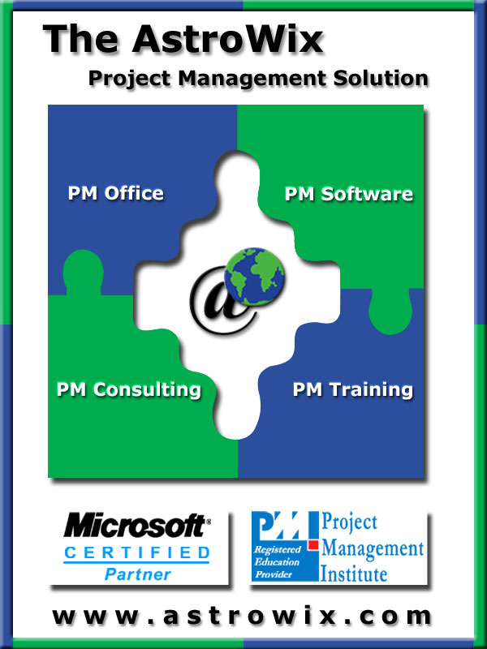
Core Competencies
Project Management Consulting
Project Management Office (PMO)
Organizational Project
Management Maturity Model
(OPM3)
Enterprise Project Management &
Portfolio Management
Project Management Software
IBM – Rational Portfolio Manager
Microsoft Project Server 2003
Project Management Training
PMP ®, CAPM ®, EPM, MSP, etc.

Slide 7

AstroWix - Partnerships
Project Management Institute - PMI®
Microsoft Corporation®
IBM® - Rational

Slide 8

Our Clients
We value the relationships that we hold between our clients and strategic partners. Our quality of work has led us to some of the industry’s biggest names. Past and current clients and projects include:
Notes:
Project Management Concepts
Version 3.1, 4/01 © 2003 by AstroWix

Slide 9
Workshop Objective
  Learn the best practices of Project Management as per PMI’s Project Management Body of Knowledge (PMBOK® Guide)
  Build confidence to apply the knowledge to day-to-day management activities
  Understand the PMP ® certification process
  Get familiarize with a large number of multiple choice questions in line with the PMP ® Certification
  Build confidence to face the PMP ® examination challenge
Notes:
Project Management Concepts
Version 3.1, 4/01 © 2003 by AstroWix

Slide 10
Agenda
Day 1
Session 1 (09.30 AM – 10-45 PM) | Introduction – AstroWix, Faculty & Participants
 | Introduction – PMI® & PMP®
 | PMP Exam overview
 | Baseline Exam & Expectation Setting
Tea Break | 10.45 AM to 11.00 AM
Session 2 (11.00 AM - 01.00 PM) | General Discussions on Project Management
Lunch Break | 01.00 PM to 02.00 PM
Session 3 (02.00 PM - 03.45 PM) | Project Management Framework
Tea Break | 03.45 PM to 4.00 PM
Session 4 (04.00 PM - 05.30 PM) | Project Integration Management
Notes:
Project Management Concepts
Version 3.1, 4/01 © 2003 by AstroWix

Slide 11
Agenda
Day 2
Session 1 (09.30 AM – 10-45 PM) | Project Scope Management
Tea Break | 10.45 AM to 11.00 AM
Session 2 (11.00 AM - 01.00 PM) | Project Time Management
Lunch Break | 01.00 PM to 02.00 PM
Session 3 (02.00 PM - 03.45 PM) | Project Cost Management
Tea Break | 03.45 PM to 4.00 PM
Session 4 (04.00 PM - 05.30 PM) | Project Quality Management
Notes:
Project Management Concepts
Version 3.1, 4/01 © 2003 by AstroWix

Slide 12
Agenda
Day 3
Session 1 (09.30 AM – 10-45 PM) | Project Human Resource Management
Tea Break | 10.45 AM to 11.00 AM
Session 2 (11.00 AM - 01.00 PM) | Project Communication Management
Lunch Break | 01.00 PM to 02.00 PM
Session 3 (02.00 PM - 03.45 PM) | Project Risk Management
Tea Break | 03.45 PM to 4.00 PM
Session 4 (04.00 PM - 05.00 PM) | Project Procurement Management
(05.00 PM - 05.30 PM) | Project Management Professional Responsibility and Ethics
Notes:
Project Management Concepts
Version 3.1, 4/01 © 2003 by AstroWix

Slide 13
Agenda continue …
Day 4
Session 1 9.30 AM – 01.00 PM | PMP® Final Exam Simulation
Session 2 2.00 PM – 03.00 PM | Final Exam review
Session 3 03.00 PM – 04.00 PM | MSP2007 Demo
Session 4 04.00 PM – 04.30 PM | Discussions and PMP® Exam Tips
Notes:
Project Management Concepts
Version 3.1, 4/01 © 2003 by AstroWix

Slide 14
PMI® & PMP®
An Overview
Notes:
Project Management Concepts
Version 3.1, 4/01 © 2003 by AstroWix

Slide 15
PMI® - Overview
Largest, not-for-profit global professional association for project
management practitioners
Established in 1969
Governed by a Board of Directors; elected “volunteer” members
PMI Offices is in Newtown Square, Pennsylvania in the USA.
Truly global membership with representation in over 130 countries.
Chapters act as “franchises”, providing education and networking
opportunities
Specific Interest Groups (SIGs), for similar industries or similar
interests.
Notes:
Project Management Concepts
Version 3.1, 4/01 © 2003 by AstroWix
Project Management Institute
PMI is the largest, not-for-profit global professional association for project management practitioners with over 100,000 members worldwide which had been providing advancement of the profession of project management knowledge since 1969. The Institute can help provide tools professionals need to transform their organization. PMI is governed by a Board of Directors which is comprised of elected “volunteer” members of the organization. The Policies of the association are implemented through the professional staff who are located at the PMI Offices in Newtown Square, Pennsylvania in the United States of America.
PMI has a truly global membership, with representation in over 130 countries. Currently there are about 300 organizations participating in our Group Billing Plan. They have almost 300 chartered and potential Chapters working toward their charters. These Chapters act as “franchises” of PMI, providing education and networking opportunities to their members located in their regions or local areas. There are Specific Interest Groups, or SIGs, are designed to bring project management practitioners in similar industries or with similar interests together in a virtual environment.
There are currently 30 SIGs and 6 potential SIGs.
Member Benefits
As a PMI member, you receive many valuable benefits that help to promote your professional and career development. These benefits include access to member’s only services as well as discounts on many of PMI’s valuable products.
Member’s Only Service
Free Copy of the latest edition of the PMBOK® Guide CD ROM
Subscriptions to PM Network®, Project Management Journal® and PMI Today™
Join PMI’s Chapters, Specific Interest Groups (SIGs) and Colleges
Access the Members Area of the Web site
Access the PMI Member Community online
PMP Certification Benefits
For individuals, the PMP certification:
Provides professional and personal recognition
Expedites professional advancement
Creates job growth and opportunities within an organization
Provides a framework for standardized project management requirements
Increases an employee’s value to the organization
A major benefit that organizations can receive via the PMP Program is that the PMP is a truly global certification.
It is considered the profession’s most global credential because it is developed by a global network of PMPs who participate in the development of the examination and the program requirements.
With today’s multi-national companies, organizations can be assured that their PMP-certified project management practitioners are speaking the same language within the practice of project management.

Slide 16
PMI® – Membership Benefits
Member’s only services and discounts on many of PMI’s valuable products
Free Copy of the latest edition of the PMBOK® Guide CD ROM
Subscriptions to PM Network®, Project Management Journal® and PMI Today™
Join PMI’s Chapters, Specific Interest Groups (SIGs) and Colleges
Access the Members Area of the Web site
Access the PMI Member Community online
http://www.pmi.org/Membership/Pages/Types-of-Memberships.aspx
Notes:
Project Management Concepts
Version 3.1, 4/01 © 2003 by AstroWix
Project Management Institute
PMI is the largest, not-for-profit global professional association for project management practitioners with over 100,000 members worldwide which had been providing advancement of the profession of project management knowledge since 1969. The Institute can help provide tools professionals need to transform their organization. PMI is governed by a Board of Directors which is comprised of elected “volunteer” members of the organization. The Policies of the association are implemented through the professional staff who are located at the PMI Offices in Newtown Square, Pennsylvania in the United States of America.
PMI has a truly global membership, with representation in over 130 countries. Currently there are about 300 organizations participating in our Group Billing Plan. They have almost 300 chartered and potential Chapters working toward their charters. These Chapters act as “franchises” of PMI, providing education and networking opportunities to their members located in their regions or local areas. There are Specific Interest Groups, or SIGs, are designed to bring project management practitioners in similar industries or with similar interests together in a virtual environment.
There are currently 30 SIGs and 6 potential SIGs.
Member Benefits
As a PMI member, you receive many valuable benefits that help to promote your professional and career development. These benefits include access to member’s only services as well as discounts on many of PMI’s valuable products.
Member’s Only Service
Free Copy of the latest edition of the PMBOK® Guide CD ROM
Subscriptions to PM Network®, Project Management Journal® and PMI Today™
Join PMI’s Chapters, Specific Interest Groups (SIGs) and Colleges
Access the Members Area of the Web site
Access the PMI Member Community online
PMP Certification Benefits
For individuals, the PMP certification:
Provides professional and personal recognition
Expedites professional advancement
Creates job growth and opportunities within an organization
Provides a framework for standardized project management requirements
Increases an employee’s value to the organization
A major benefit that organizations can receive via the PMP Program is that the PMP is a truly global certification.
It is considered the profession’s most global credential because it is developed by a global network of PMPs who participate in the development of the examination and the program requirements.
With today’s multi-national companies, organizations can be assured that their PMP-certified project management practitioners are speaking the same language within the practice of project management.

Slide 17
PMP® – Certification Benefits
Provides professional and personal recognition
Expedites professional advancement
Creates job growth and opportunities within an organization
Provides a framework for standardized project management requirements
Increases an employee’s value to the organization
A major benefit that organizations - a truly global
certification.
PMI Certified Project Managers are a preferred lot by any organization worldwide
High Demand due to short supply of Certified Project Managers
Increase in compensation within the organization
Notes:
Project Management Concepts
Version 3.1, 4/01 © 2003 by AstroWix
Project Management Institute
PMI is the largest, not-for-profit global professional association for project management practitioners with over 100,000 members worldwide which had been providing advancement of the profession of project management knowledge since 1969. The Institute can help provide tools professionals need to transform their organization. PMI is governed by a Board of Directors which is comprised of elected “volunteer” members of the organization. The Policies of the association are implemented through the professional staff who are located at the PMI Offices in Newtown Square, Pennsylvania in the United States of America.
PMI has a truly global membership, with representation in over 130 countries. Currently there are about 300 organizations participating in our Group Billing Plan. They have almost 300 chartered and potential Chapters working toward their charters. These Chapters act as “franchises” of PMI, providing education and networking opportunities to their members located in their regions or local areas. There are Specific Interest Groups, or SIGs, are designed to bring project management practitioners in similar industries or with similar interests together in a virtual environment.
There are currently 30 SIGs and 6 potential SIGs.
Member Benefits
As a PMI member, you receive many valuable benefits that help to promote your professional and career development. These benefits include access to member’s only services as well as discounts on many of PMI’s valuable products.
Member’s Only Service
Free Copy of the latest edition of the PMBOK® Guide CD ROM
Subscriptions to PM Network®, Project Management Journal® and PMI Today™
Join PMI’s Chapters, Specific Interest Groups (SIGs) and Colleges
Access the Members Area of the Web site
Access the PMI Member Community online
PMP Certification Benefits
For individuals, the PMP certification:
Provides professional and personal recognition
Expedites professional advancement
Creates job growth and opportunities within an organization
Provides a framework for standardized project management requirements
Increases an employee’s value to the organization
A major benefit that organizations can receive via the PMP Program is that the PMP is a truly global certification.
It is considered the profession’s most global credential because it is developed by a global network of PMPs who participate in the development of the examination and the program requirements.
With today’s multi-national companies, organizations can be assured that their PMP-certified project management practitioners are speaking the same language within the practice of project management.

Slide 18
Project Management Standards
Projects
  PMBOK 4th Edition, 2008
  Schedule Management
  Risk Management
  Configuration Management
  Practice Standard for Work Break Down Structure
  Practice Standard for Earn Value Management
  Construction Extension
  Government Extensions
  Portfolio
  Portfolio Management
  Program
  Program Management
  Organization
  OPM3
  People
  Project Manager Competency Development Framework Profession

Slide 19
Project Management Standards
PMI’s A Guide to the Project Management
Body of Knowledge (PMBOK ® Guide)
4th Edition
PMI Worldwide: www.pmi.org
www.pminorthindia.org
Notes:
Project Management Concepts
Version 3.1, 4/01 © 2003 by AstroWix

Slide 20
PMP Prerequisite
Secondary Diploma + 5 Years + 7500 Hours + 35 PDU
Or
4 years degree + 3 years + 4500 Hours + 35 PDU

Slide 21
Costs of Certification
Registration fees for 35 Contact Hours program through a R.E.P
PMP Examination Fees
  Non-Members USD $555
  PMI Members USD $405
Re-Examination Fees
  Non-Members USD $375
  PMI Members USD $275

Slide 22
Validity of Certification
Certificate Maintenance
PMP® Certification is valid for 3 Years
One has to maintain the PMP® Certification through Continuous Certification Requirement(CCR) norms laid down by PMI which requires that a Certified PMP has to earn 60 Professional Development Units(PDU) over a period of 36 months (3 Years). This can be done in several ways and there are specific guidelines laid down to earn a PDU.

Slide 23









PMP
Seven steps in the Journey towards PMP®
7
Execute,Succeed & Celebrate
Time : 4 Hours
R
E
F
E
R
E
N
C
E
B
O
O
K
S
6
Submit Fees (Cost : US$ 405)
get eligibility letter schedule Exam
5
Receipt of PMP examination eligibility
notice from PMI ( (Time : two weeks))
4
Submit PMP examination Application.
3
Prepare for Exam
2
Mandatory training/PM education for
35 hours of credits (chapter,university,institute or REP)
1
Become a PMI member. Cost 129 US $.
Time span : On line or One week

Slide 24
Execute, Succeed and Celebrate
Examination is four hours, 200 question
To pass you must get 106 correct out of 175, 25 question will be pre-test questions spread throughout the exam
No negative marks
The result will be announced soon after the exam ( online)
The Postal confirmation will come two weeks later with certificate, label pin and appreciation letter
Breakup of questions is as below:
  Project initiation : 17
  Planning : 47
  Execution : 47
  Controlling : 46
  Project Closure : 14
  PMP Professional responsibility : 29
  Total : 200

Slide 25
Validity of Certification
Ways to Earn PDU
Get from PMI website
  Co-author PM book
  Participate in Project Management Events
  Write paper on PM
  Speak from PMI platforms
  Write articles on PM
  Attend PM related training programs

Slide 26

Certification Benefits - Organization
Implement Professional Best Practices in Project Management across the organization
Achieve Organizational Project Management Maturity Model (OPM3®) a Standard developed by PMI
Be in the league to beat any competition

Slide 27
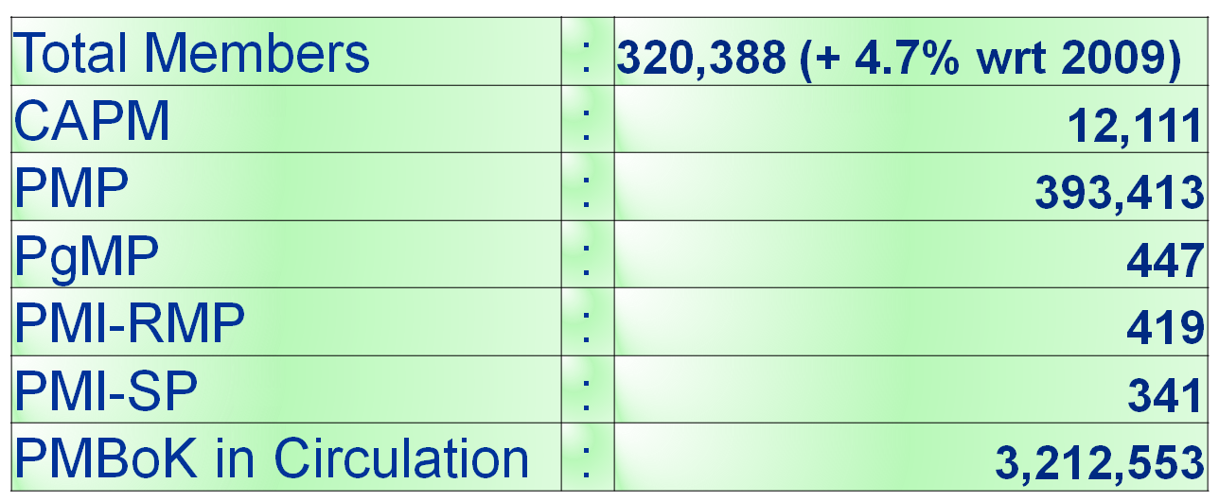
Demand for PMP Certification
September- 2010
Global Numbers

Slide 28









Project Management Body of Knowledge
Scope Management
Time Management
Cost Management
Quality Management
Integration Management
Human Resources Management
Communications Management
Risk Management
Procurement Management
Professional Responsibility & Ethics
Notes:
Project Management Concepts
Version 3.1, 4/01 © 2003 by AstroWix

Slide 29


Topics for Examination
Professional Responsibility & Ethics
Senses of Elephants are Stakeholders
Communication
Project Manager
Procurement
Scope
HR
Time
Cost
Risk
Integration
Quality
Notes:
Project Management Concepts
Version 3.1, 4/01 © 2003 by AstroWix

Slide 30
Topics for Examination
  Project Initiation
  Project Planning
  Project Execution
  Project Control
  Project Closing
  Professional Responsibility
Notes:
Project Management Concepts
Version 3.1, 4/01 © 2003 by AstroWix

Slide 31
Project Initiation [11%]
  Define Scope
  Document Project Risks, Assumptions, and Constraints
  Identify and Perform Stakeholder Analysis
  Develop Project Charter
  Obtain Project Charter Approval
Notes:
Project Management Concepts
Version 3.1, 4/01 © 2003 by AstroWix

Slide 32
Project Planning [ 23%]
  Define and Record Requirements, Constraints and
  Assumptions
  Identify Project Team and Define Roles and
  Responsibilities
  Create the WBS
  Develop Change Management Plan
  Identify Risks and Define Risk Strategies
  Obtain Plan Approval
  Conduct Kick-off Meeting
Notes:
Project Management Concepts
Version 3.1, 4/01 © 2003 by AstroWix

Slide 33
Project Execution [27%]
  Execute Tasks Defined in Project Plan
  Ensure Common Understanding and Set Expectations
  Implement the Procurement of Project Resources
  Manage Resource Allocation
  Implement Quality Management Plan
  Implement Approved Changes
  Implement Approved Actions and Workarounds
  Improve Team Performance
Notes:
Project Management Concepts
Version 3.1, 4/01 © 2003 by AstroWix

Slide 34
Project Monitoring & Control [21%]
  Measure Project Performance
  Verify and Manage Changes to the Project
  Ensure Project Deliverables Conform to Quality Standards
  Monitor all Risks
Notes:
Project Management Concepts
Version 3.1, 4/01 © 2003 by AstroWix

Slide 35
Project Closing [9%]
  Obtain Final Acceptance for the Project
  Obtain Financial, Legal, and Administrative Closure
  Identify, Document and Communicate Lessons Learned
  Create and Distribute Final Project Report
  Archive and Retain Project Records
  Measure Customer Satisfaction
  Release Project Resources
Notes:
Project Management Concepts
Version 3.1, 4/01 © 2003 by AstroWix

Slide 36
Professional & Social Responsibility [9%]
  Ensure Individual Integrity
  Contribute to the Project Management Knowledge Base
  Enhance Personal Professional Competence
  Promote Interaction Among Stakeholders
Notes:
Project Management Concepts
Version 3.1, 4/01 © 2003 by AstroWix

Slide 37
Base Line!
Notes:
Project Management Concepts
Version 3.1, 4/01 © 2003 by AstroWix

Slide 38
Discussions!
Notes:
Project Management Concepts
Version 3.1, 4/01 © 2003 by AstroWix

